Slide 1
Welcome!
Please register, have a drink and snack, and grab a seat.
We’ll start at <time>
UNLOCKING PUBLIC SECTOR AI
Not for external distribution
1

Slide 2
Centre for the Fourth Industrial Revolution
AI Procurement Simulation with <agency/agencies participating>
<date>
Not for external distribution

Slide 3
Detailed agenda
Morning discussions will build a common understanding of the factors shaping procurement and of the simulation exercise.
Time | Session
09.30 - 09.45 | Welcome and introduction to the simulation session <leader/organization> remarks
09.45 - 10.45 | Review of procurement guidelines <presenter> presentation
10.45 - 11.00 | Introduction to key challenges <presenter> presentation
11.00 - 11.30 | Review of technology procurement process in your jurisdiction <presenter> presentation
11.30 - 11.45 | Break
11.45 - 12.15 | Review of data protection regulation your jurisdiction <presenter> presentation
12.15 - 12.45 | Presentation of simulation RFP <presenter> presentation
12.45 - 13.30 | Lunch
13.30 - 14.00 | Panel on RFP <facilitator> moderated
14.00 - 15.30 | Addressing the challenges Group activity
15.30 - 15.45 | Break
15.45 - 16.00 | Debrief and wrap up
UNLOCKING PUBLIC SECTOR AI
Not for external distribution
5

Slide 4
Day 2 overview: Introduction to the simulation
How do we simulate adoption of the guidelines?
The guidelines do not propose a new procurement process per se, rather changes on how to use existing processes and legislative environments more effectively.
UNLOCKING PUBLIC SECTOR AI
Not for external distribution
34

Slide 5
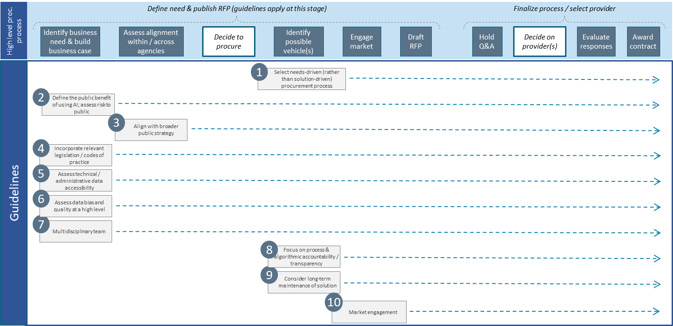
Day 2 overview: Introduction to the simulation
How do we simulate adoption of the guidelines?
This map provides an overview of which guidelines are important to consider at which stage of the process
UNLOCKING PUBLIC SECTOR AI
Not for external distribution
34

Slide 6
Day 2 overview: Introduction to the simulation
How do we simulate adoption of the guidelines?
It is about understanding the impact (‘challenges’) of the proposed changes on existing processes
Approach
High-level agenda
Day 1 insights
1. Establish a baseline
Review the guidelines
Introduce proposed key challenges
Review current tech procurement process and data protection regulation in <country/organization>
Current state analysis
Current procurement processes, data privacy regulation
Adoption strategies
2. Set up the simulation
Present mock RFP
Provide high-level thoughts on the new process
Anticipated challenges
Our goal: to understand how to adopt the guidelines
3. Simulate challenges and identify solutions
Mock RFP
Review/amend the challenges
Break into groups to discuss the challenges and how to address them, both strategically and tactically
Present findings to room
UNLOCKING PUBLIC SECTOR AI
Not for external distribution
34

Slide 7
Overview of procurement guidelines
Reading time
Not for external distribution

Slide 8
Review the guidelines individually
25 min. Go through guidelines 1-5 (pages 7-12)
5 min. Discussion
25 min. Go through guidelines 6-10 (pages 12-16)
5 min. Discussion
Silent reading, please step outside for phone calls and conversations
Not for external distribution
30

Slide 9
Overview of AI procurement guidelines (1 of 4)
Guideline | Key concepts
1. Use a suitable procurement process | Use innovation-oriented procurement processes Examples: challenged-based procurement, innovation partnerships Problem/opportunity over solution Hard to define a clear problem statement, but it pays off Leverage private sector for what they do best: the tech Favour iterative development AI requires multiple training cycles, so it’s well-suited for Agile
2. Define the public benefit of using AI while assessing risks | Define why AI vs any other approach Leverage vendors; pre-market engagement key Business case calls out public benefit and risks; human-centred design Success/failure criteria framed from public perspective High-level initial risk and impact assessment User needs, unintended consequences, affected groups, bias
Not for external distribution
30

Slide 10
Overview of AI procurement guidelines (2 of 4)
Guideline | Key concepts
3. Consider national and local AI strategy, if available | High-level understanding of current national/local AI approach Leverage past experience, from within or other agencies Consult early adopters, even where success was limited Create platforms for collaboration and knowledge-sharing
4. Follow all applicable laws | Be aware of data/privacy and other applicable regulation Human/civil rights Balance vendor confidentiality needs with transparency
5. Assess data accessibility/availability | Data governance, for procurement and project Determine high-level data availability/accessibility Consider third-party data when required Consider sharing data during procurement Mutually beneficial, with right conditions
Not for external distribution
30

Slide 11
Overview of AI procurement guidelines (3 of 4)
Guideline | Key concepts
6. Assess data use ethics | Privacy needs vary (e.g. weather vs health data). Integrity is a constant Data needs to be fair Have consent Is recent, representative, unbiased, well understood
7. Diverse, multidisciplinary team | AI is a very multidisciplinary field Team diversity reflects population who will be affected
8. Accountability and transparency | Decision-making needs to be explainable to those it affects Explainability vs accuracy Documentation on algorithm (e.g. data used, training methodology) Need for contestability Accountability required for AI systems in government
Not for external distribution
30

Slide 12
Overview of AI procurement guidelines (4 of 4)
Guideline | Key concepts
9. Lifecycle management | AI requires continuous assessment/re-training Monitoring and re-training capabilities Agreement with vendor (in-house, vendor, third party?) Training and knowledge transfer Tailored training for all roles affected Knowledge transfer for relevant IT roles Auditability of system by third parties
10. Market engagement | Work collaboratively and engage early Consider wide variety of partners (e.g. academia, researchers) Pre-RFP, use vendors to validate assumptions/feasibility Engage (i.e. RFP Q&A) Avoid vendor lock-in e.g. royalty-free licensing, public domain publication terms Clear expectations of who owns what IP
Not for external distribution
30

Slide 13
Introduction to the challenges
Not for external distribution

Slide 14
Introduction to the challenges
Agile but responsible access to data assets
Data-sharing between government agencies and with vendors
Intellectual property ownership between government agencies and vendors
Quick assembly of diverse teams with required skill set
Adhering to guidelines without creating additional process delays/burden
Not for external distribution
30

Slide 15
Technology procurement process in <country/organization>
Not for external distribution

Slide 16
Break (15 min.)
Then…
Review of data protection regulation in <country/organization>
Presentation of simulation RFP
Not for external distribution

Slide 17
Data protection in <country/agency>
Not for external distribution

Slide 18
Introduction to the simulation RFP
Not for external distribution

Slide 19
The mock RFP
Overview of original RFP
Business need
…
Key business requirements
…
Procurement process
…
UNLOCKING PUBLIC SECTOR AI
Not for external distribution
10
Notes:
Give examples: a car can’t translate, siri can’t drive
ANI: doesn’t mean that it’s not transformational because it’s not AGI. It’s a key component of the 4IR and offers a major shift to our world

Slide 20
The mock RFP
Alignment to the guidelines
RFP sections amended | Applicable guideline(s) | Change
… | … | …
… | … | …
… | … | …
… | … | …
… | … | …
UNLOCKING PUBLIC SECTOR AI
Not for external distribution
10
Notes:
Give examples: a car can’t translate, siri can’t drive
ANI: doesn’t mean that it’s not transformational because it’s not AGI. It’s a key component of the 4IR and offers a major shift to our world

Slide 21
Lunch (45 min.)
Then …
Panel discussion on the RFP
Breakout activity: How to address the challenges
Not for external distribution

Slide 22
Panel
<Panelist 1>
<Organization>
<Panelist 2>
<Organization>
<Panelist 3>
<Organization>
<Panelist 4>
<Organization>
<Panelist 5>
<Organization>
Not for external distribution
11

Slide 23
Addressing the challenges
Not for external distribution

Slide 24
Introduction to the challenges
Agile but responsible access to data assets
Data-sharing between government agencies and with vendors
Intellectual property ownership between government agencies and vendors
Quick assembly of diverse teams with required skill set
Adhering to guidelines without creating additional process delays/burden
Not for external distribution
30

Slide 25
Breakout activity: Key opportunities for <country/org>
60 min. | Objective: solve one key challenge
What short and medium/long-term changes would address your group’s key challenge?
15 min. break after 60 min. exercise
Reconvene in plenary room for debrief and wrap up at 15.45.
UNLOCKING PUBLIC SECTOR AI
Not for external distribution
33

Slide 26
Thank You | Questions?
Not for external distribution

